Slide 1




The Battle of Neighborhoods: Starting a Chinese Restaurant in Seattle
IBM Data Science Capstone Project
Jing Yang 03/2021

Slide 2

Seattle, a seaport city on the West Coast of the United States, is full of business opportunities.
Tags of Seattle: #tourismCity #stateParks #education #diversity
Business problem: Where are the best positions to open a Chinese restaurant?

Slide 3
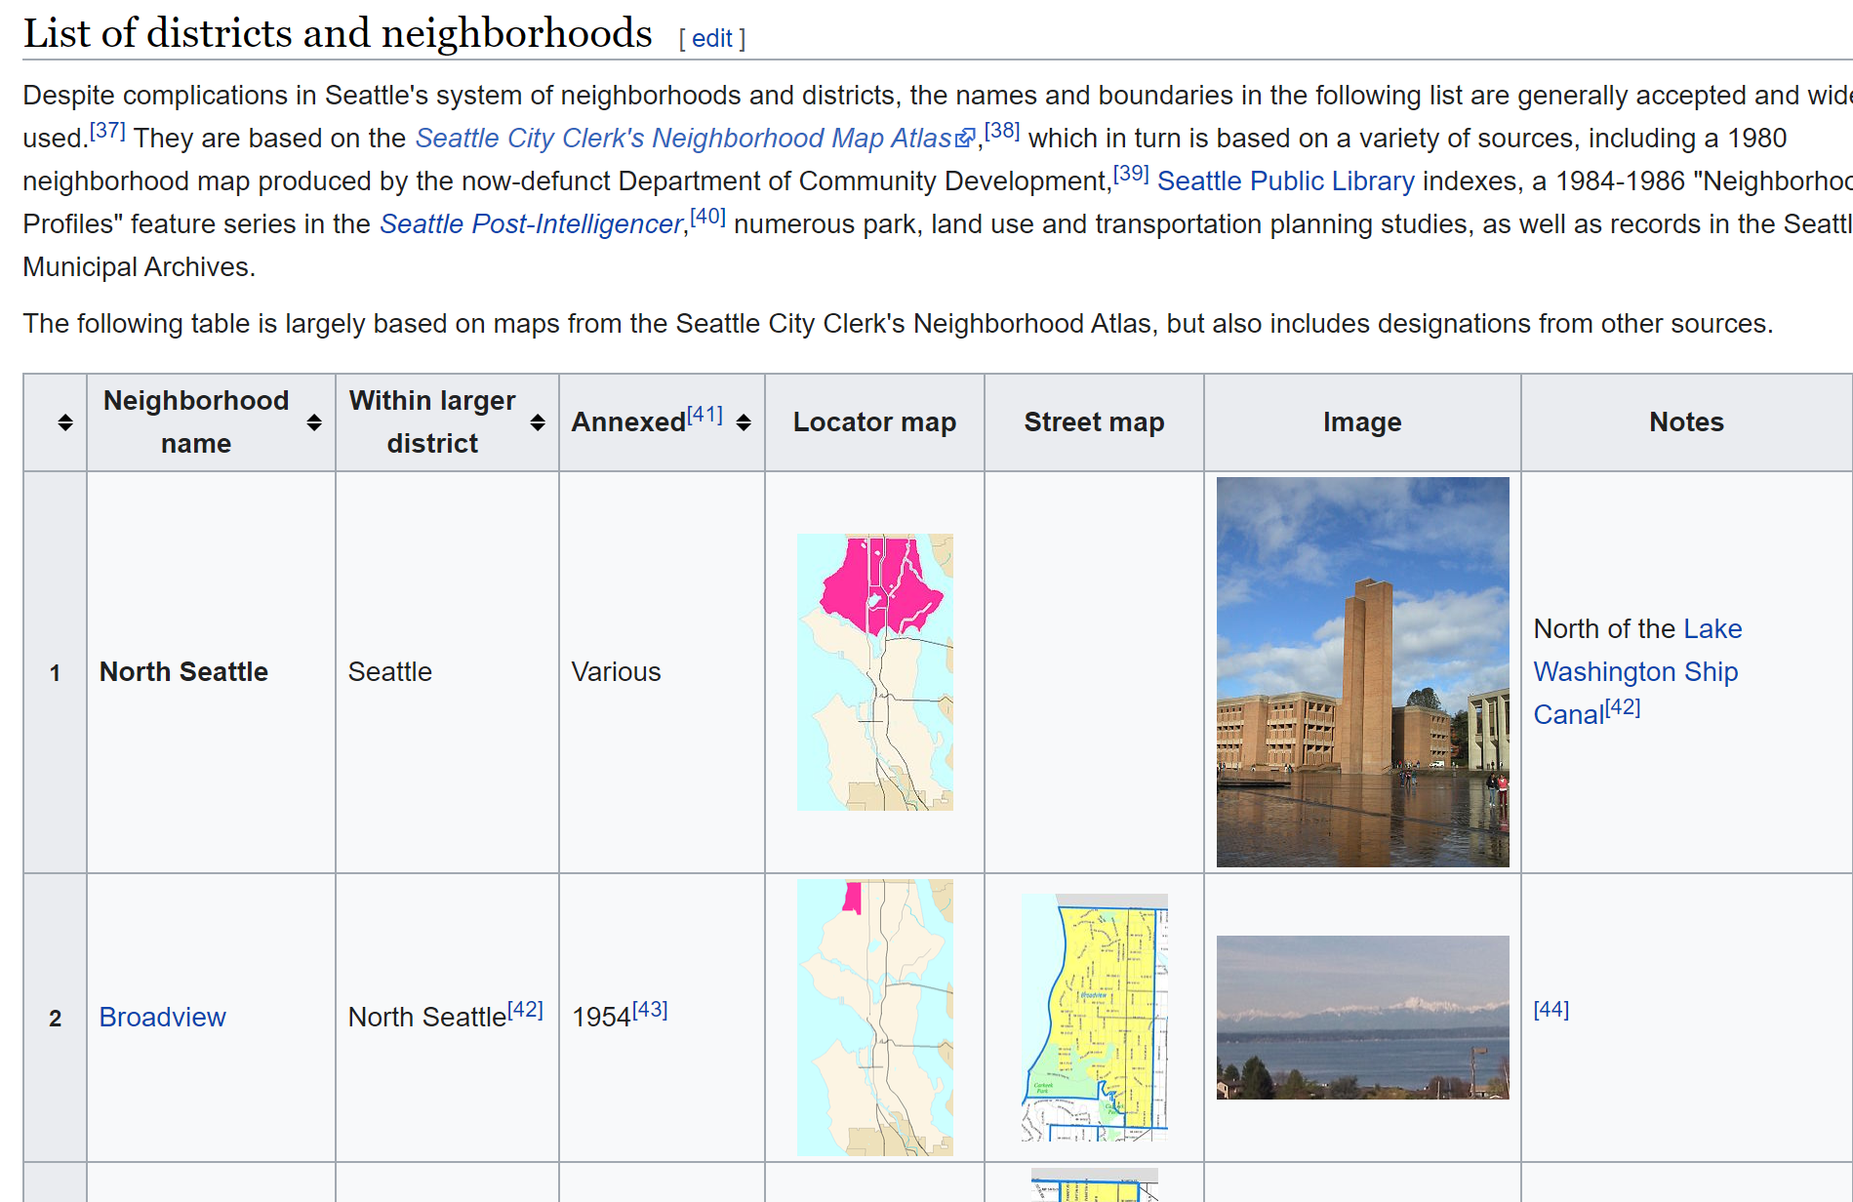
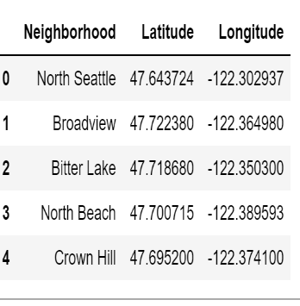
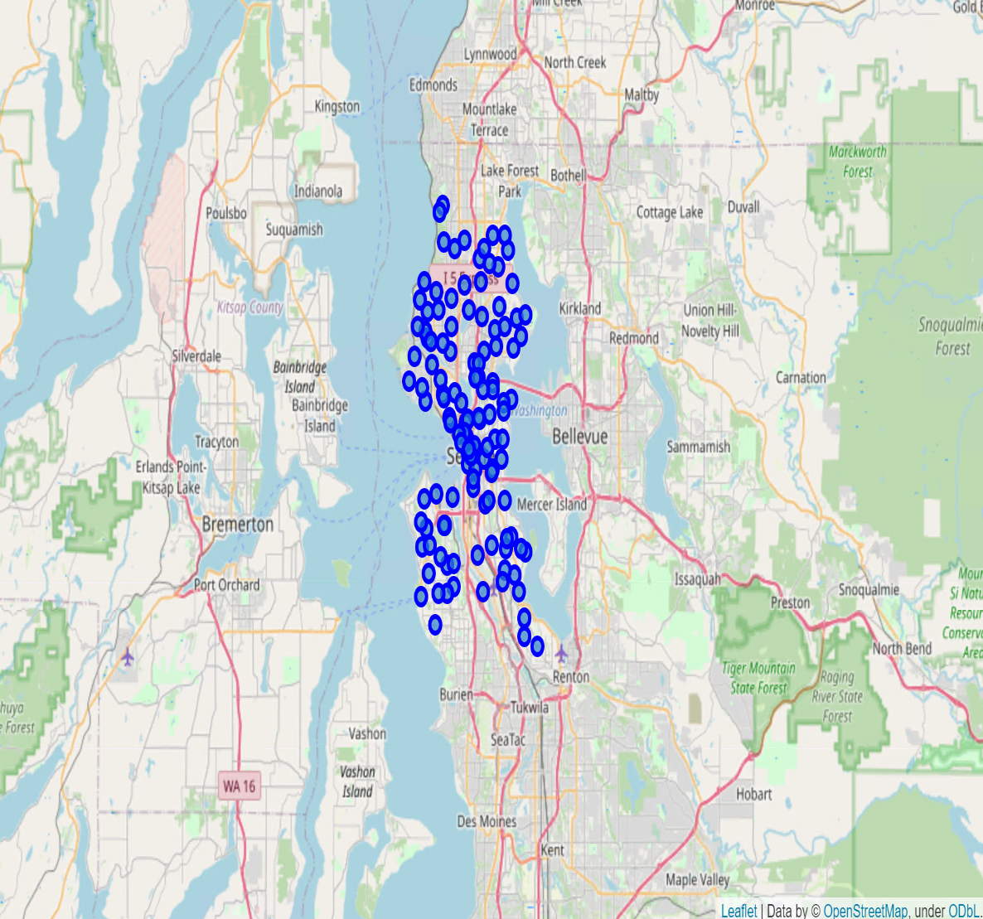
Data Acquisition
1
List of neighborhoods in Seattle from Wikipedia: https://en.wikipedia.org/wiki/List_of_neighborhoods_in_Seattle
2
Read as dataframe using BeautifulSoup and Requests packages with Python
Latitude and Longitude data from geocoder

Slide 4
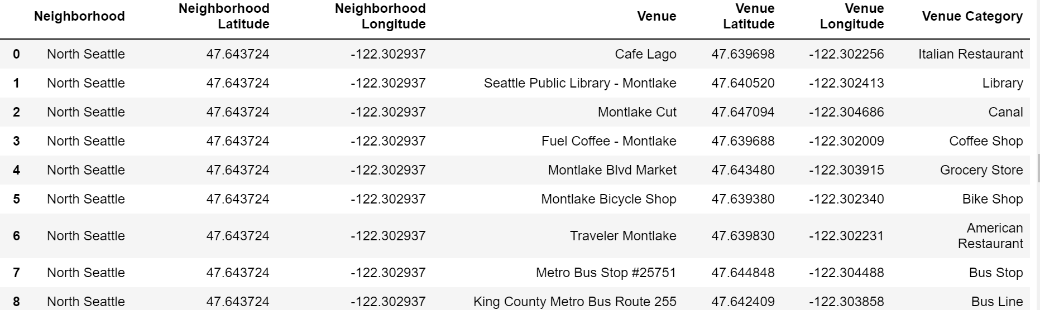
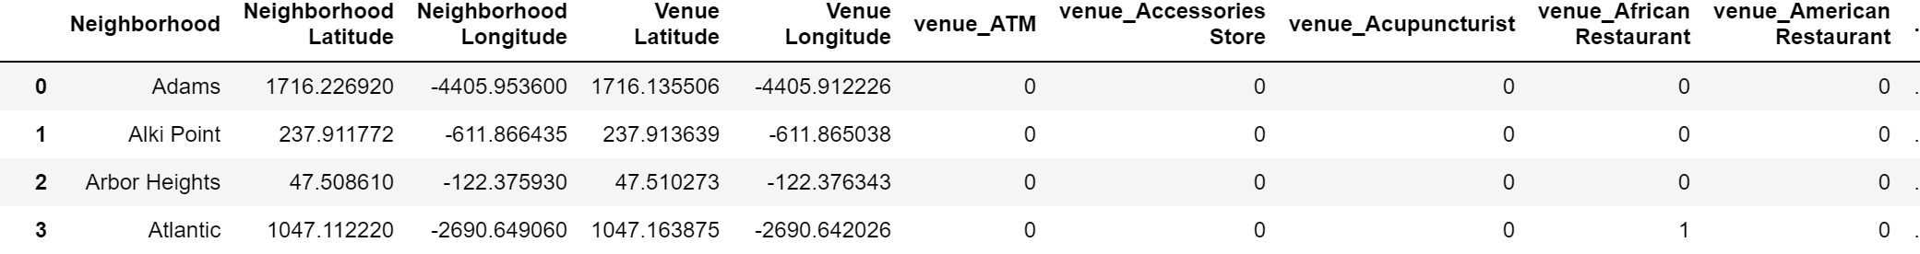
Slide 3
3
All data of venues in each neighborhoods is obtained from Foursquare API. There are 127 official neighborhoods and 2970 venues in Seattle
4
Venue Category is applied with one-hot encoding to obtain the frequency of different types of venues

Slide 5
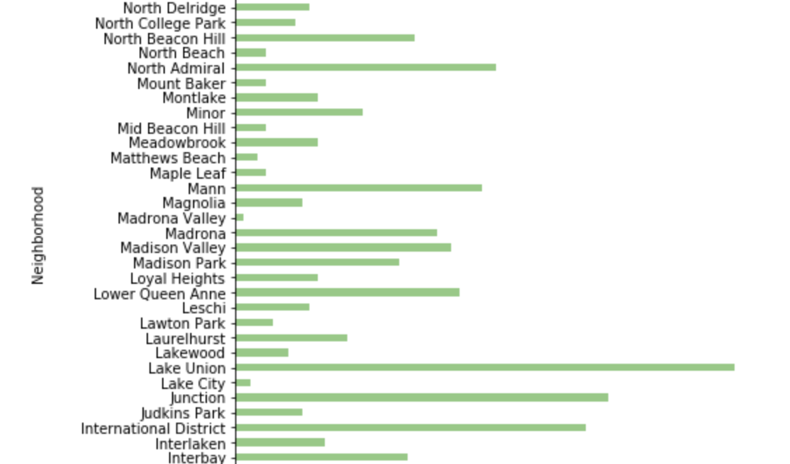
EDA
Number of venues
Notes:
When conducting research, it is easy to go to one source: Wikipedia. However, you need to include a variety of sources in your research. Consider the following sources:
Who can I interview to get more information on the topic?
Is the topic current and will it be relevant to my audience?
What articles, blogs, and magazines may have something related to my topic?
Is there a YouTube video on the topic? If so, what is it about?
What images can I find related to the topic?

Slide 6
Methodology
Shopping: Shopping malls
Competition: Chinese restaurants
Large customer flow: plus score
Eating: Restaurants
Education: Universities
Entertainment: Theaters
Travel: Museums, Parks
Feature Selection:
Minus score
Notes:
When conducting research, it is easy to go to one source: Wikipedia. However, you need to include a variety of sources in your research. Consider the following sources:
Who can I interview to get more information on the topic?
Is the topic current and will it be relevant to my audience?
What articles, blogs, and magazines may have something related to my topic?
Is there a YouTube video on the topic? If so, what is it about?
What images can I find related to the topic?

Slide 7
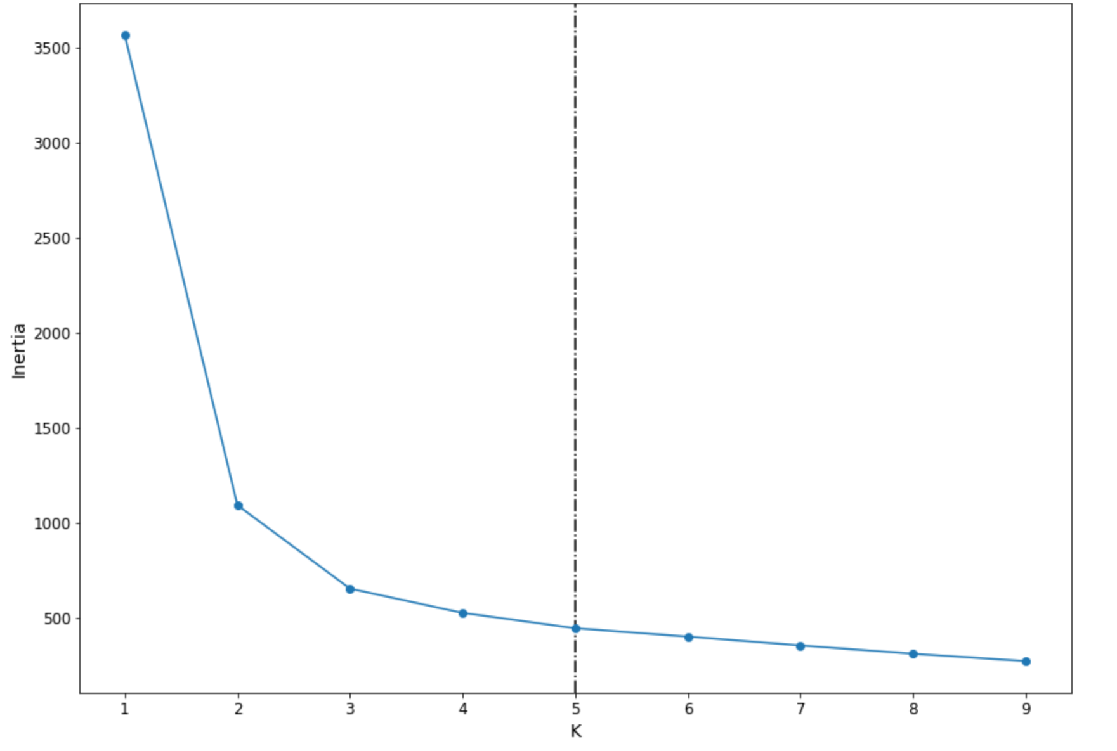
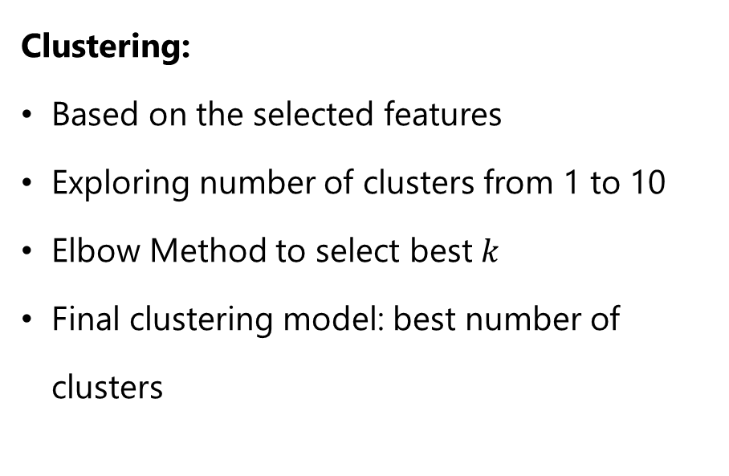
Methodology
Clustering:
Based on the selected features
Exploring number of clusters from 1 to 10
Elbow Method to select best $k$
Final clustering model: best number of clusters
Notes:
When conducting research, it is easy to go to one source: Wikipedia. However, you need to include a variety of sources in your research. Consider the following sources:
Who can I interview to get more information on the topic?
Is the topic current and will it be relevant to my audience?
What articles, blogs, and magazines may have something related to my topic?
Is there a YouTube video on the topic? If so, what is it about?
What images can I find related to the topic?

Slide 8
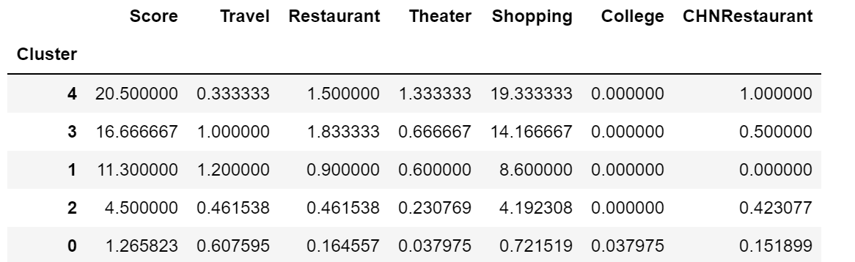
Methodology
Scoring Clusters:
Score = #of restaurants + #of colleges + #of universities + #of shops + #of tourism – 2*#of Chinese restaurants
Cluster 4 has the highest score!
Notes:
When conducting research, it is easy to go to one source: Wikipedia. However, you need to include a variety of sources in your research. Consider the following sources:
Who can I interview to get more information on the topic?
Is the topic current and will it be relevant to my audience?
What articles, blogs, and magazines may have something related to my topic?
Is there a YouTube video on the topic? If so, what is it about?
What images can I find related to the topic?

Slide 9
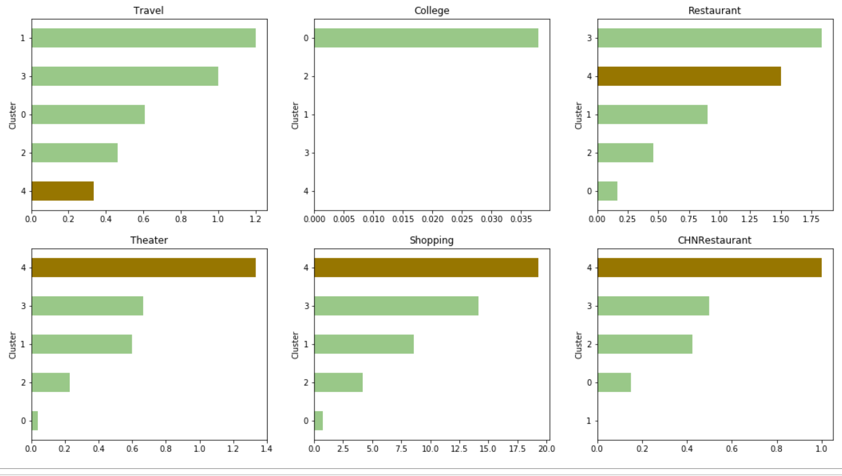
Results
Check the distribution of venues in Cluster 4:
Refer to the notes section below for guidelines on this topic.
Notes:
Once you find your sources, you will want to evaluate your sources using the following questions:
Author:
Who is the author?
Why should I believe what he or she has to say on the topic?
Is the author seen as an expert on the topic? How do you know?
Current:
How current is the information in the source?
When was the source published?
Is the information out-of-date?
Accuracy:
Is the content accurate?
Is the information presented objectively? Do they share the pros and cons?

Slide 10
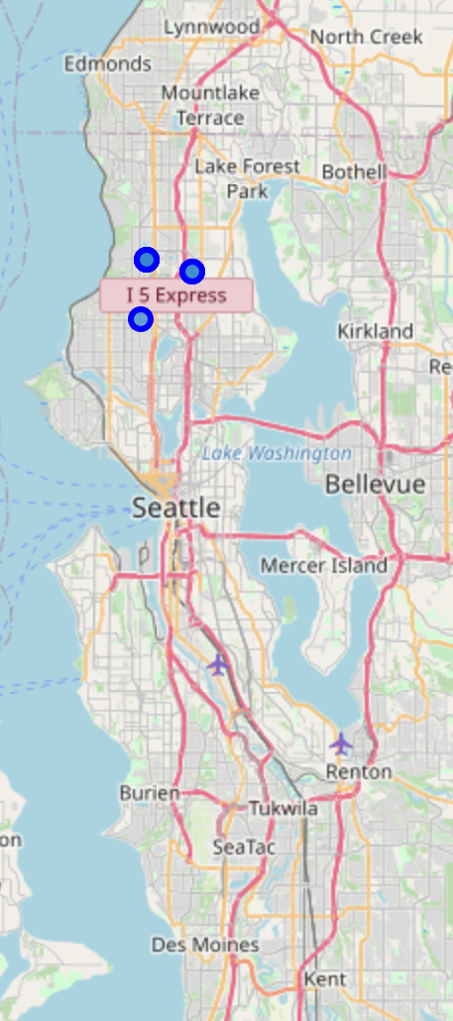
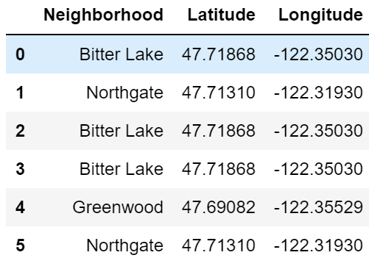
Results
Top 6 neighborhoods in Cluster 4:
Notes:
Once you find your sources, you will want to evaluate your sources using the following questions:
Author:
Who is the author?
Why should I believe what he or she has to say on the topic?
Is the author seen as an expert on the topic? How do you know?
Current:
How current is the information in the source?
When was the source published?
Is the information out-of-date?
Accuracy:
Is the content accurate?
Is the information presented objectively? Do they share the pros and cons?

Slide 11
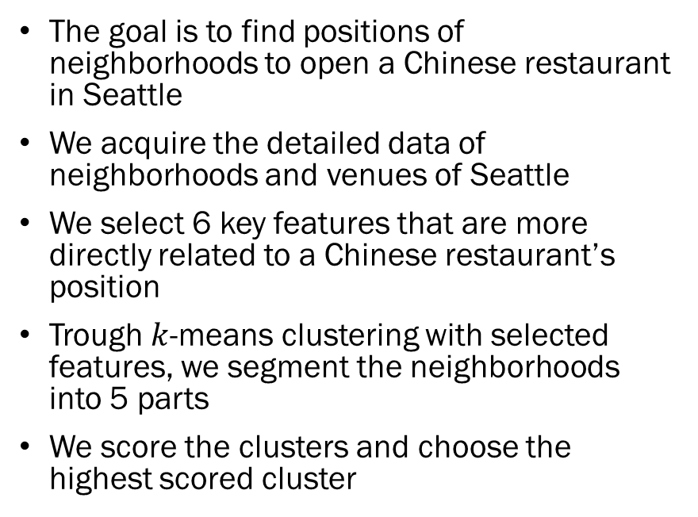
Conclusion & Discussion
The goal is to find positions of neighborhoods to open a Chinese restaurant in Seattle
We acquire the detailed data of neighborhoods and venues of Seattle
We select 6 key features that are more directly related to a Chinese restaurant’s position
Trough $k$-means clustering with selected features, we segment the neighborhoods into 5 parts
We score the clusters and choose the highest scored cluster
Notes:
After you’ve done your research, it’s time to put your presentation together. The first step in the process is to introduce the topic. This is a great time to connect your topic to something that your audience can relate. In other words, why should they listen to all the information you will be sharing in your research presentation? What is in it for them? You may also want to include a graphic or image to grab their attention.
Feel free to duplicate this slide by right-clicking on this slide in the slides pane to the left and select Duplicate Slide.
The next step in your presentation is to state your claim or topic clearly. Your teacher may even call this your thesis. As you state your thesis, you may find that this layout is not the best layout for your claim or topic. You can change the layout by clicking the drop-down menu next to the Layout in the Slides menu section. You can choose Two Content, Comparison, or Picture with Caption. Note: A different layout might change the look of the icons on this page.
You will also want to state your facts. You have done the research now share some of the interesting facts with your audience. Facts do not have to be boring; you can communicate facts in a variety of ways by going to the Insert Tab. In the Insert tab you can:
Insert pictures from your computer or online.
Add a chart
Create some SmartArt
Insert a variety of icons to help your facts come to life. Note: You can change the color of the icons by selecting the icon and then click on the Format tab and then Graphics Fill. From there, you will choose a color from the list or choose More Fill Colors to give you more options.
Since this research presentation is a result of your hard work and searching, you want to make sure you support the claims or points in your presentation with facts from your research findings. Make sure you give the author proper credit for helping you share your ideas. If one of your sources has a video that is relevant to your topic, you can add the video as added support. Keep in mind the length of the video and the amount of time you have for your presentation. For a 5 minute speech, the video should be no longer than 30 seconds.
Questions to consider:
How will you state the author of the source?
Will you need to cite the source on the slide?
What are some ways you can engage your audience so they feel like they are a part of the presentation? Some ideas to consider is by taking a quick poll like: by a show of hands, how many of you think school uniforms are a way to cut down on bullying? Another suggestion is to have them hold up a certain number of fingers to see if they agree or disagree. Finally, you can share a story that the audience can relate to that makes them laugh.
After all the applause, your audience may have some questions. Be prepared to answer some of their questions by making a list of questions you think they might ask. You may also want to share the presentation with them by providing the link to your presentation, if they want more information.

Slide 12
Thank you!
Notes:
You can use this slide as your opening or closing slide. Should you choose to use it as a closing, make sure you review the main points of your presentation. One creative way to do that is by adding animations to the various graphics on a slide. This slide has 4 different graphics, and, when you view the slideshow, you will see that you can click to reveal the next graphic. Similarly, as you review the main topics in your presentation, you may want each point to show up when you are addressing that topic.
Add animation to images and graphics:
Select your image or graphic.
Click on the Animations tab.
Choose from the options. The animation for this slide is “Split”. The drop-down menu in the Animation section gives even more animations you can use.
If you have multiple graphics or images, you will see a number appear next to it that notes the order of the animations.
Note: You will want to choose the animations carefully. You do not want to make your audience dizzy from your presentation.

